Slide 1
Menus
Notes:
https://developer.android.com/guide/topics/ui/menus

Slide 2
Menus or Action Presentation Types
Options menu and app bar
Context menu and contextual action mode
Popup menu

Slide 3
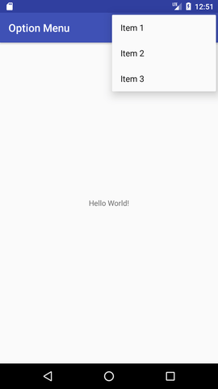

Options menu and App bar
Example: App bar
Example: Option menu

Slide 4
App Bar
Also known as the action bar, is one of the most important design elements in your app's activities.
It provides a visual structure and interactive elements that are familiar to users.
Using the app bar makes your app consistent with other Android apps, allowing users to quickly understand how to operate your app and have a great experience.

Slide 5
App Bar
The key functions of the app bar are as follows:
A dedicated space for giving your app an identity and indicating the user's location in the app.
Access to important actions in a predictable way, such as search.
Support for navigation and view switching (with tabs or drop-down lists).

Slide 6
Option Menu
The options menu is where you should include actions and other options that are relevant to the current activity context, such as "Search," "Compose email," and "Settings."

Slide 7
Contextual Menus
A contextual menu offers actions that affect a specific item or context frame in the UI.
You can provide a context menu for any view, but they are most often used for items in a ListView, GridView, or other view collections in which the user can perform direct actions on each item.

Slide 8
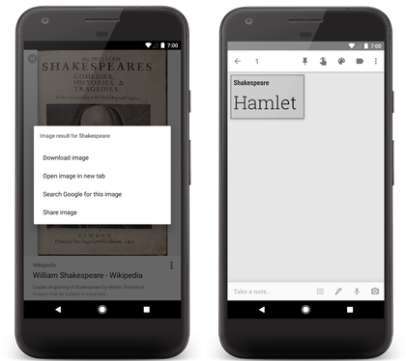
Contextual Menus
There are two ways to provide contextual actions:
Floating context menu mode
Contextual action mode

Slide 9
1. Floating context menu mode
A menu appears as a floating list of menu items (similar to a dialog) when the user performs a long-click on a view that declares support for a context menu.
Users can perform a contextual action on one item at a time.

Slide 10
2. Contextual action mode
This mode is a system implementation of ActionMode that displays a contextual action bar at the top of the screen with action items that affect the selected item(s).
When this mode is active, users can perform an action on multiple items at once (if your app allows it).

Slide 11
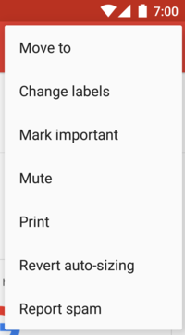
Popup Menu
A PopupMenu is a menu anchored to a View.
It appears below the anchor view if there is room, or above the view otherwise.

Slide 12
Popup Menu
It is useful for:
Providing an overflow-style menu for actions that relate to specific content (such as Gmail's email headers).
Providing a second part of a command sentence (such as a button marked "Add" that produces a popup menu with different "Add" options).
Providing a drop-down similar to Spinner that does not retain a persistent selection.

Slide 13
Managing Option Menu
Steps:
Create a menu resource file (xml).
Usually in src\main\res\menu
Within onCreateOptionsMenu of activity inflate menu.
Use onOptionsItemSelected callback to handle selection events for menu items.

Slide 14
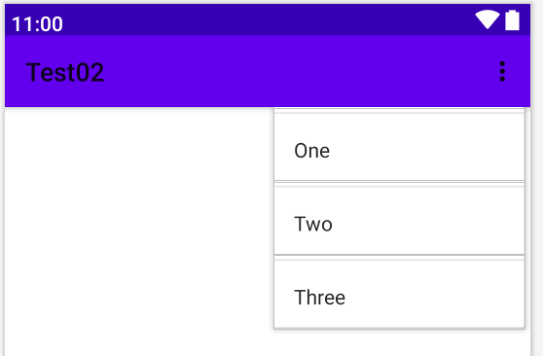
Managing Option Menu
(1)Create a menu resource file (xml).
<?xml version="1.0" encoding="utf-8"?> <menu xmlns:android="http://schemas.android.com/apk/res/android" xmlns:app="http://schemas.android.com/apk/res-auto" xmlns:tools="http://schemas.android.com/tools" tools:context=".MainActivity"> <item android:id="@+id/action_one" android:title="One" /> <item android:id="@+id/action_two" android:title="Two" /> <item android:id="@+id/action_three" android:title="Three" /> </menu>

Slide 15
Managing Option Menu
(2) Within onCreateOptionsMenu of activity inflate menu.
public class MainActivity extends AppCompatActivity { . . . @Override public boolean onCreateOptionsMenu(Menu menu) { MenuInflater inflater = getMenuInflater(); inflater.inflate(R.menu.menu_one, menu); return true; } }

Slide 16
Managing Option Menu
(3) Use onOptionsItemSelected callback to handle selection events for menu items.
public class MainActivity extends AppCompatActivity { @Override public boolean onOptionsItemSelected(@NonNull MenuItem item) { switch(item.getItemId()){ case R.id.action_one: break; case R.id.action_two: break; case R.id.action_three: break; } return true;//consumed } }

Slide 17
Managing floating context menu
Steps:
Create a menu resource file (xml).
Register the View to which the context menu should be associated by calling registerForContextMenu() and pass it the View.
Implement the onCreateContextMenu() method in your Activity.
Implement onContextItemSelected() in your Activity.

Slide 18
Managing popup menu
Steps:
Create a menu resource file (xml).
Create a popup menu and associate it to a view.
Set onMenuItemClickListner of popup menu.
Inflate popup menu.
Show popup menu.

Slide 19
Managing popup menu
Steps: Create a popup menu and associate it to a view.
public boolean onLongClick(View v) { PopupMenu popup = new PopupMenu(this, v); MenuInflater inflater = popup.getMenuInflater(); inflater.inflate(R.menu.popup1, popup.getMenu()); popup.show(); return false; }

Slide 20
Managing popup menu
Steps: Set onMenuItemClickListner of popup menu.
public class MainActivity extends AppCompatActivity implements PopupMenu.OnMenuItemClickListener { ... @Override public boolean onMenuItemClick(MenuItem item) { return false; } }

